Slide 1
Trainity project 4
Hiring Process Analytics
Chetan Vishwakarma

Slide 2
Project description:
Project consists of a excel file which contains the data of the people that are getting hired or rejected and the salary offered to the individual.
It mainly consists of columns like application_id, interview taken on, status, Gender, Department, post name and offered salary.
We need to use excel spreadsheets and the tools for obtaining the insights from the file.
There are some unknown values like (-) in the columns like event_name and post name.
Hence, cleaning the data using mode in categorical columns and median in the numerical column if required.
Replacing the (-) with “Male” in event_name column and “c5” in post name column because the mode value for these variables is the highest of all the remaining in there column.

Slide 3
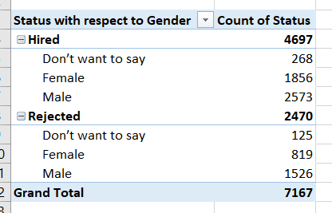
A. Hiring Analysis: The hiring process involves bringing new individuals into the organization for various roles.
Your Task: Determine the gender distribution of hires. How many males and females have been hired by the company?
Approach: Firstly, created a pivot table, used Event_name column firstly in rows and then placed status column in rows, since we need the count of people hired with respect to gender, hence made the count of Status using the values section in the pivot analysis table.

Slide 4
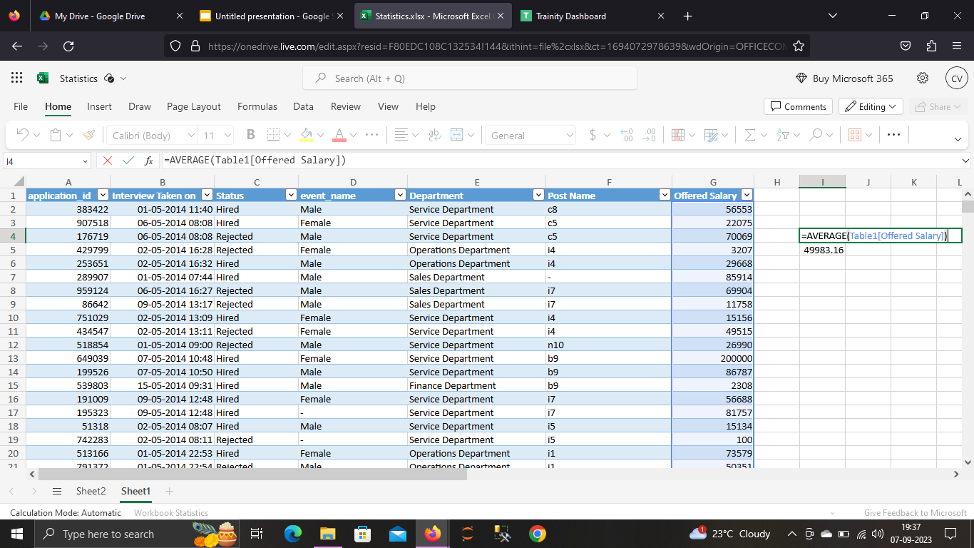
B. Salary Analysis: The average salary is calculated by adding up the salaries of a group of employees and then dividing the total by the number of employees.
Your Task: What is the average salary offered by this company? Use Excel functions to calculate this.

Slide 5
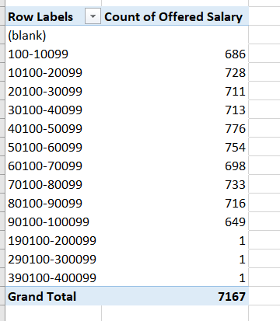
C. Salary Distribution: Class intervals represent ranges of values, in this case, salary ranges. The class interval is the difference between the upper and lower limits of a class.
Your Task: Create class intervals for the salaries in the company. This will help you understand the salary distribution.
Approach : For class intervals, we firstly obtained a chart containing offered salary and respective count of the offered salary using Pivot table.
Then, Selected the offered salary column which was produced using the pivot table, and used function group by right clicking the selected column and given values of maximum and minimum and provide the value of intervals.

Slide 6
D. Departmental Analysis: Visualizing data through charts and plots is a crucial part of data analysis.
Your Task: Use a pie chart, bar graph, or any other suitable visualization to show the proportion of people working in different departments.
Approach: Firstly created a pivot table in which one column consisted of post name and the other column consisted of the count of people present in that respective post.
After creating the table, using the data from table the bar chart and pie chart were produced.

Slide 7
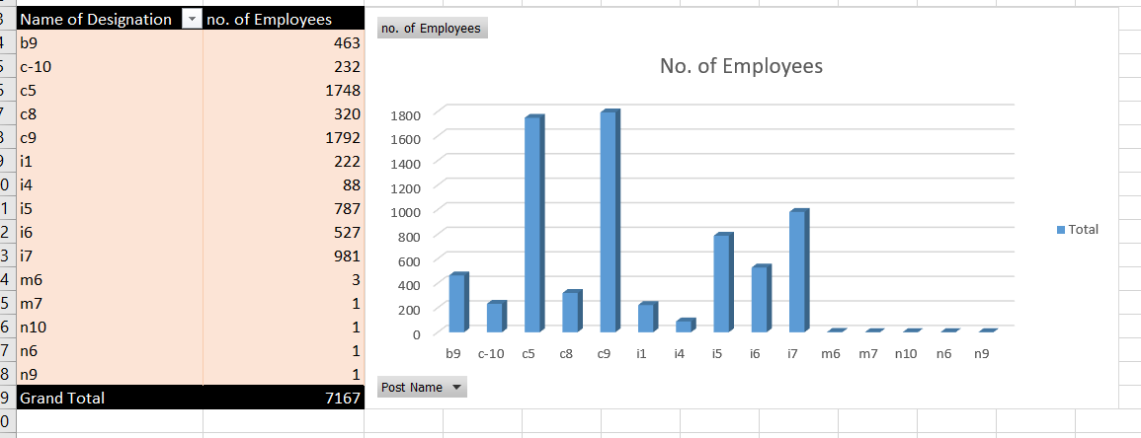

Slide 8
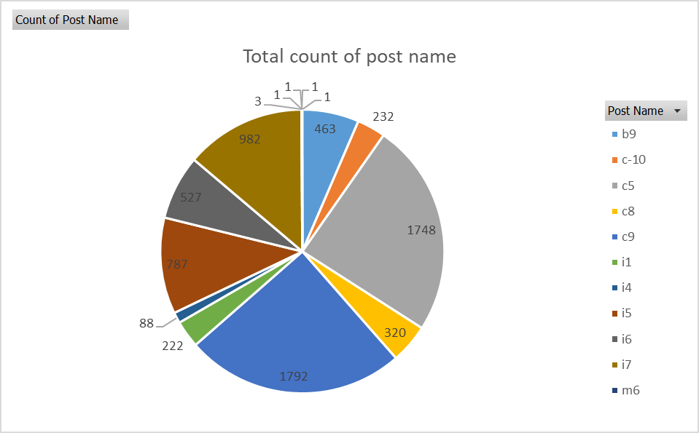

Slide 9
E. Position Tier Analysis: Different positions within a company often have different tiers or levels.
Your Task: Use a chart or graph to represent the different position tiers within the company. This will help you understand the distribution of positions across different tiers.
Approach: To obtain the values with respect to different positions within the company having different tiers we firstly create a pivot table in which we place department column in the rows section and then after placing the post name beneath in the rows section.
To obtain the count of people, we place the post name column in the values section.
Using the pivot table, then we obtain the bar chart showing the count of people present on the different post with respect to different departments present in the company.
It can be clearly seen that operations department has highest number of people followed by service department

Slide 10
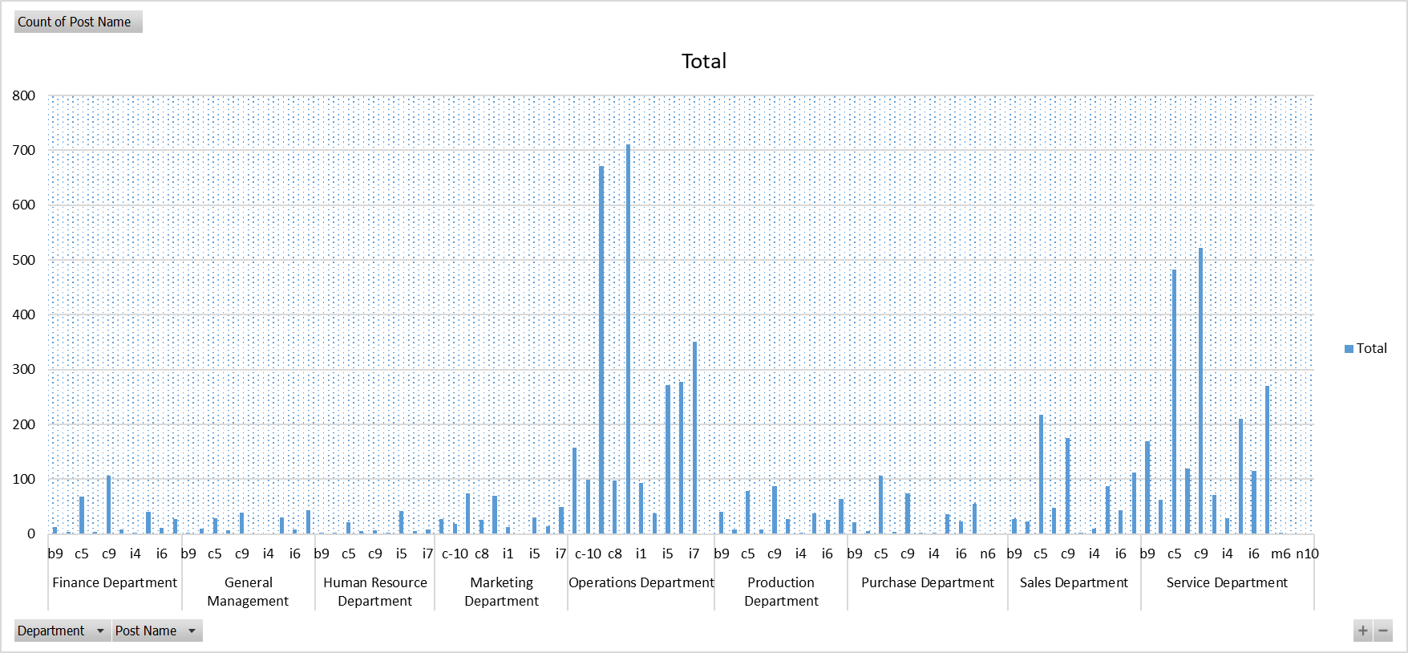
Bar chart showing no. of people present in different departments of the company

Slide 11
Result:
Good practice of excel worksheet and tools
Got clearity in pivot tables and charts that can be produced using the pivot table
Had a good practice in using the functions in the excel sheet.
Able to read and understand the data.
Renaming missing values, outlier treatments and use of mean, median, mode in the data

